Slide 1
DBF Senior Design Proposal
Ricky Ortiz, Daniel Noronha, Matt Zagrocki

Slide 2

Introduction
Collaborating with Notre Dame's DBF Club to develop an autonomous glider for the 2025 AIAA Design Build Fly Competition
Focused on designing the electronics system, including an ESP32 microcontroller to process sensor data and control flight surfaces
The goal is to achieve a lightweight, autonomous glider capable of precise navigation and scoring highly in the competition

Slide 3

Problem Description
The glider must adhere to the constraints outlined by the AIAA Design Build Fly Competition
Objective is to ensure the glider meets all competition requirements, maximizes bonus points, and demonstrates reliable flight performance

Slide 4
AIAA Competition Constraints
Launch altitude: 200-400 feet.
Weight limit: 0.55 lbs (250 grams)
Prohibited Equipment: Radio Receivers
Flight Control Method: Determined by team
Storage and Launch:
Glider must fit between the airplane’s two external fuel tanks
Must remained secured to the airplane during all flight stages except the mission launch
Minimum gap of 0.25 inches between the airplane fuselage and glider wings

Slide 5
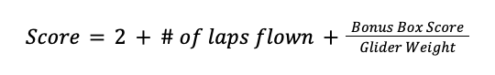
AIAA Scoring Criteria
Number of laps completed by the main aircraft
Weight of the glider
Proximity of the glider to the landing zone

Slide 6
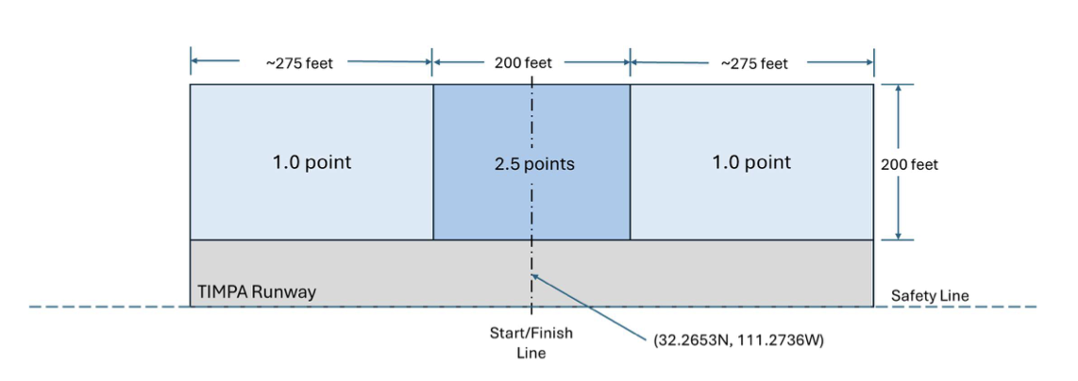
Opportunities for Bonus Points
Execute 180 degree turn post launch
Strobe lights turn on only after glider release
Follow a control descent or landing pattern to land in highest-scoring zones
No bonus points awarded if landing is outside the bonus boxes

Slide 7
Proposed Solution
Develop an electronic system centered around an ESP32 microcontroller to process data and control flight surfaces
Integrate sensors, including an IMU, GPS module, and pitot tube, to allow precise navigation and autonomous flight
Implement a PID control algorithm for real-time adjustments to ailerons and elevator
Utilize strobe lights triggered by launch conditions
Use a proximity sensor to detect when the Glider has been launched from the Main Aircraft

Slide 8
Demonstrated Features
Launch Mechanism
Launch mechanism ensures reliable deployment of the glider
Enable transition to autonomous flight without failed launches
Flight Control Surface Actuation
The glider will demonstrate actuation of the flight control surfaces
Proper flight control surface actuation is critical for scoring
Strobe Lights
The strobe lights activate after the glider is launched from the airplane
Must identify launch conditions and trigger lights at the right time

Slide 9
Demonstrated Features
Video of Landing Precision
Video of glider demonstrating its ability to land in the designated scoring zone, specifically the 2.5 points
This achievement will be essential to a competitive performance in the competition
Optimized Weight and Power Systems
Glider will demonstrate its lightweight construction to meet the maximum weight limit of 0.55 pounds
It will show versatility in power sourcing, being able to operate on either USB or LiPo battery power

Slide 10
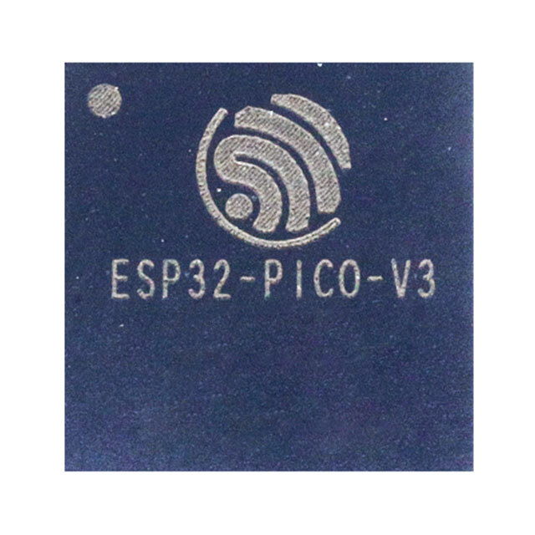
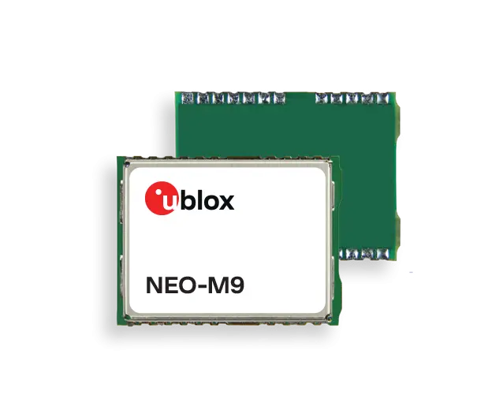
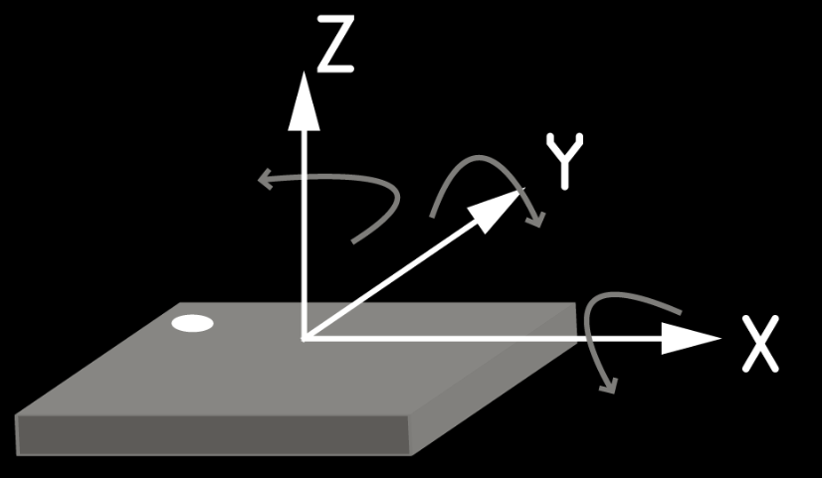
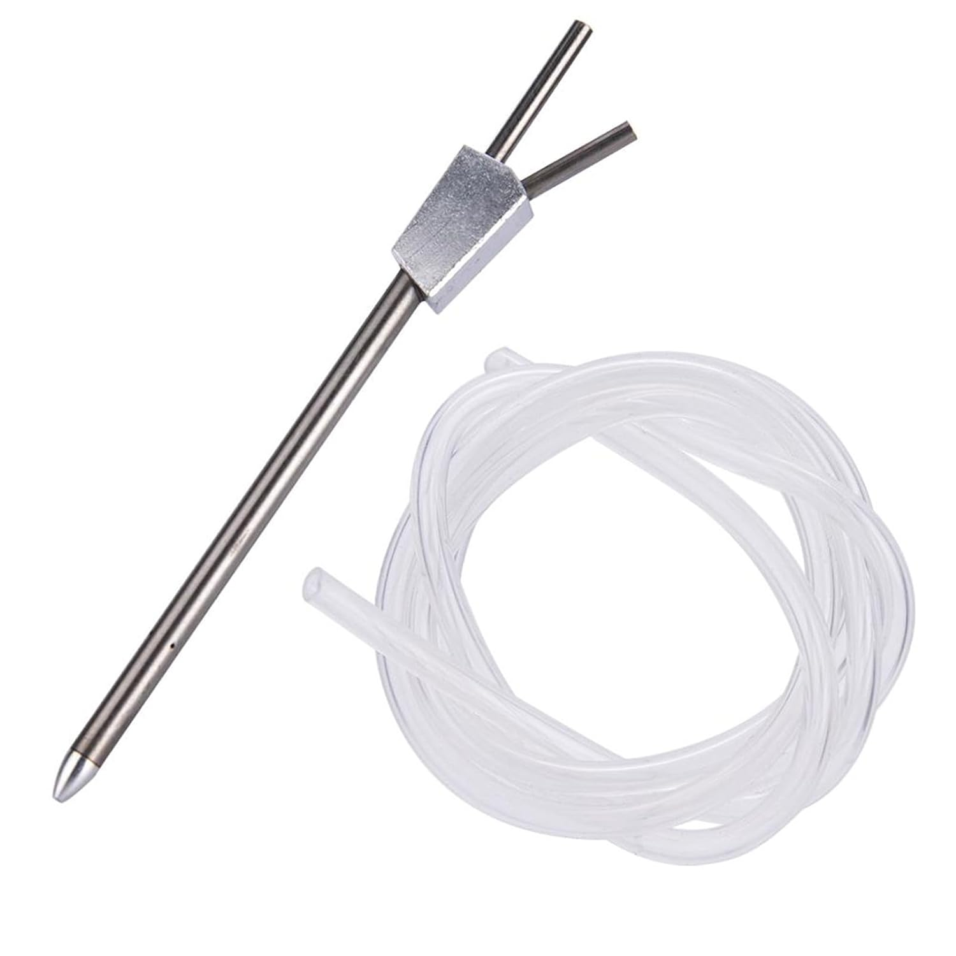
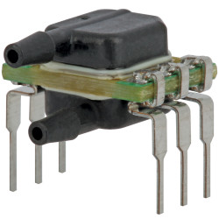
Available Technologies
Central Microcontroller
ESP32-PICO-V3-02
GPS Module
NEO-M9N
Inertial Measurement Unit
BNO085
Pitot Tube (Differential Pressure Sensor)
ABP2DRRT001PD2A3XX

Slide 11
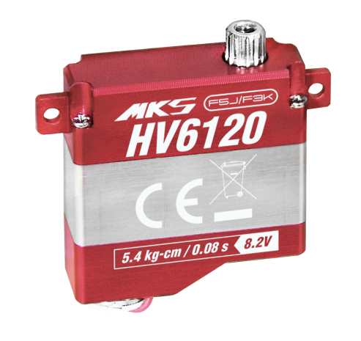
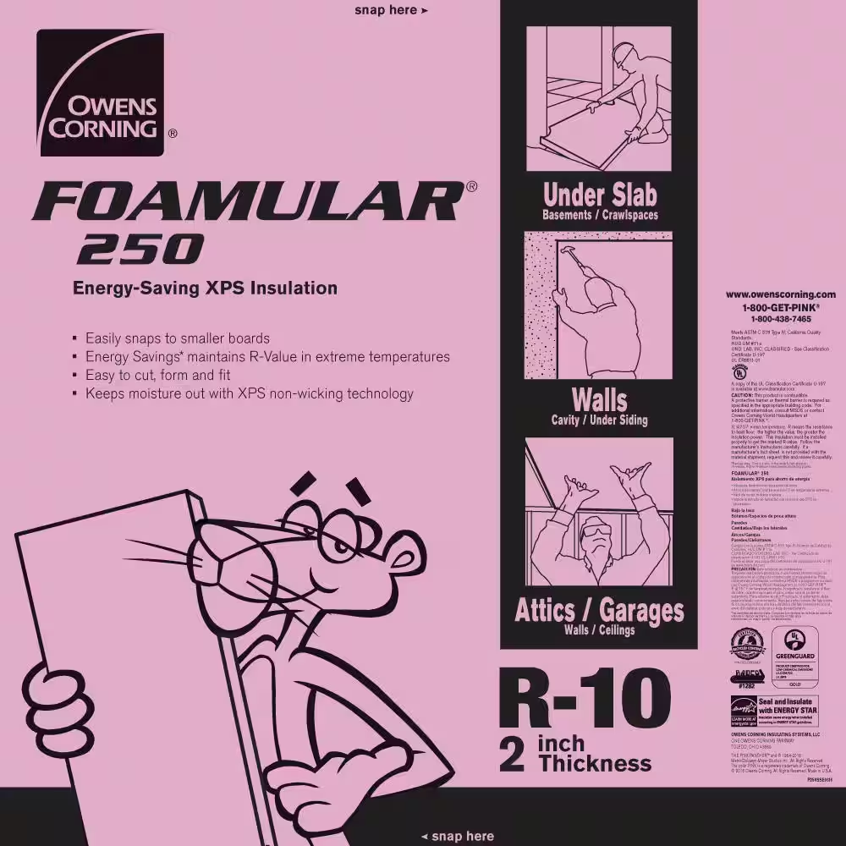
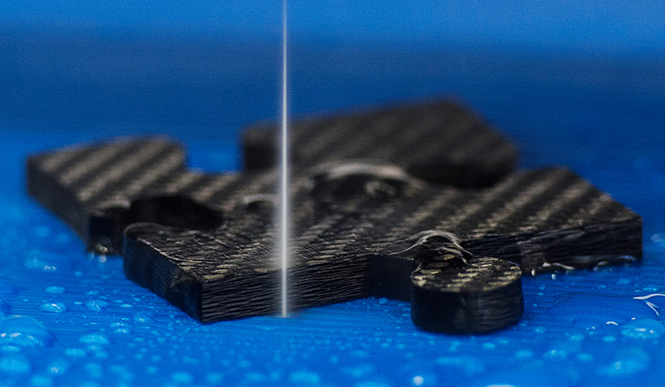
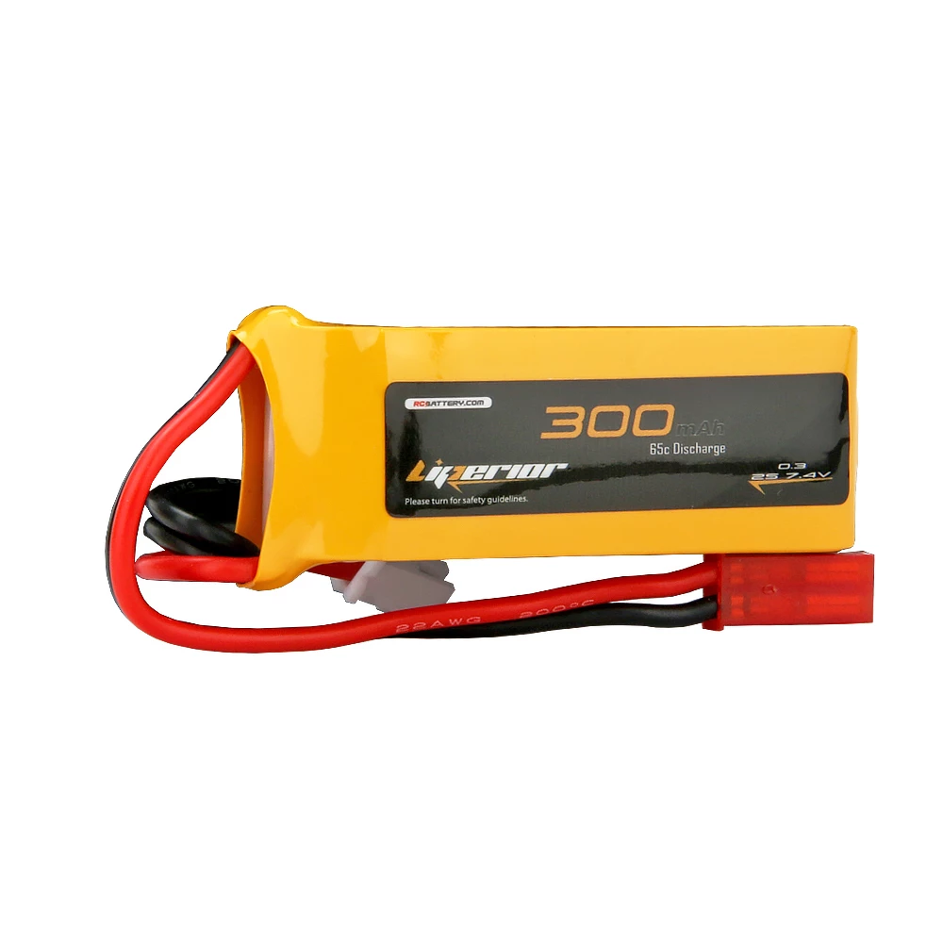
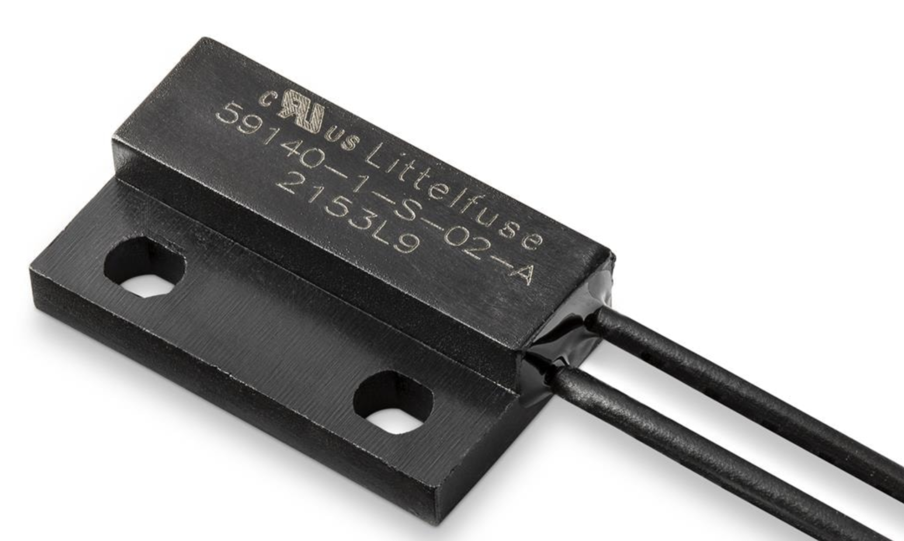
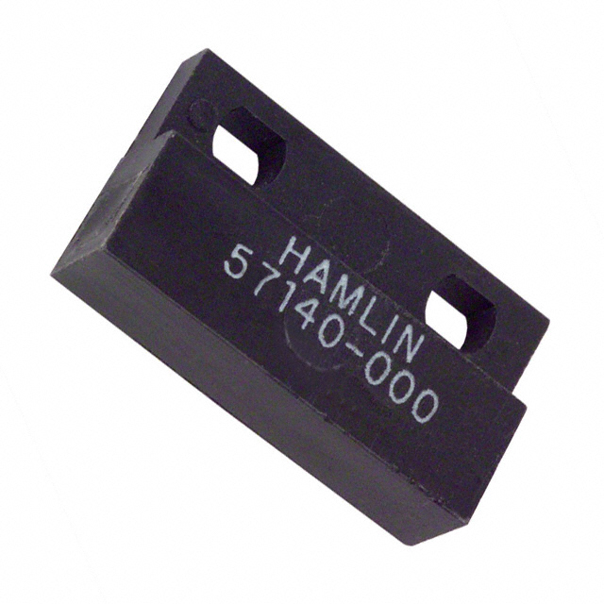
Available Technologies
Motors
MKS Servos
Construction Materials
XPS Foam and Carbon Fiber
Battery
2s 300mAh LiPo
Proximity Sensors
Hamlin 59140-010
Hamlin 57140-000

Slide 12
Engineering Content
Schematic Design
Develop a comprehensive circuit schematic incorporating the ESP32, sensors, servos, and power systems to ensure proper functionality and integration.
PCB Design and Layout
Optimize the circuit board for minimal size and weight while ensuring manufacturability.
Overall CAD Design of Glider
Coordinate with Aerodynamics and Structures team to ensure compatibility and proper integration with the Glider

Slide 13
Engineering Content
Programming and Control Logic
Implement FreeRTOS for task scheduling, sensor data processing, and PID-based control of flight surfaces for precise navigation
Testing and Validation
Conduct flight tests to verify system functionality, refine algorithms, and ensure competition readiness

Slide 14
Conclusions
Our project designs the electronics for an autonomous glider to meet AIAA Design Build Fly competition goals
The glider will demonstrate precise flight control, reliable navigation, and lightweight construction for optimal performance
Successful implementation involves integrating sensors, motors, and a real-time operating system into a compact design
The project blends principles of electrical, aeronautical, and mechanical engineering and is an exploration into the feasibility of autonomous flight

Slide 15
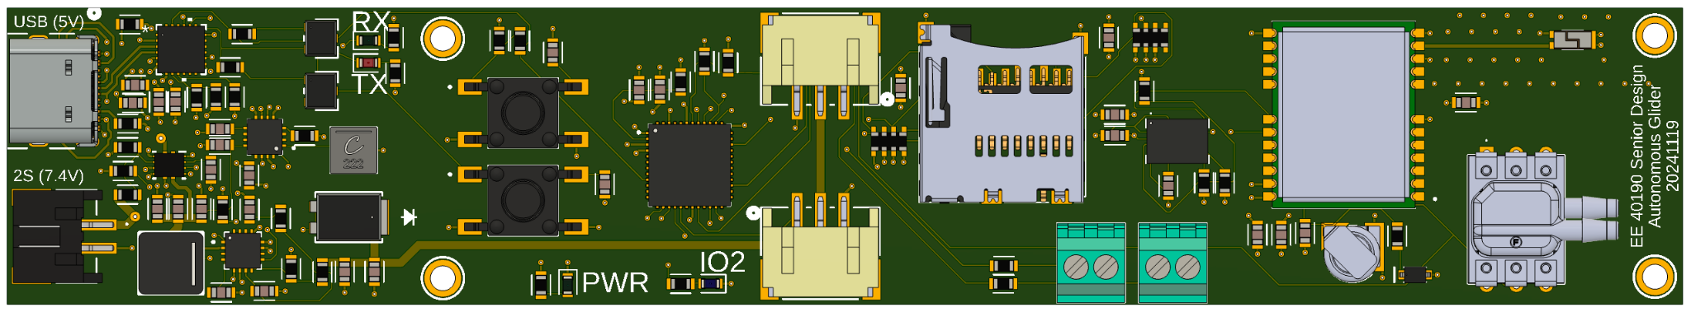
Current Progress

